Slide 1
Prompt Engineering
Owais Hussain

Slide 2
Contents
Prompt structuring
Shot Prompting
Prompt Parameters
Hallucination
Source verification
Iterative refinement

Slide 3
Prompt Structuring
What is Prompt Engineering?
Generally, we communicate like: کمیٹی کا میسج آیا تھا۔ گیارہ سے پانچ تک کے الیکٹرک والے کام کریں گے۔ پانی فل کر دینا۔
LLMs are different. They understand the context from the prompt:
I received a notification from the building administration. There will be power outage from 11AM to 5PM today for maintenance work by K-electric. Remind me to fill up overhead water tank at 9AM.
Prompt structuring is providing a well-organized set of directions to LLM
Presentation
Framing
Role Assignment
Try on ChatGPT :
“Write an essay, criticizing Hyderabadi biryani”
“You are a chef judging different Biryanis cooked in your game show. Write a critique on Hyderabadi Biryani in 5 bullet points, explaining different aspects of its demerits against other Biryanis.”
Notes:
Prompt engineering is the art of explain the LLM how to think and act
Presentation: bullet points, summary, story-like
Framing: set context limits and direct the outcome
Role Assignment: set who to act like
Finally, replace the role from Chef to a Nutritionist

Slide 4
Shot Prompting
Zero-shot Prompting
“Rate this feedback as Positive, Negative or Mixed: I tried your Hyderabadi Biryani last night. The taste and smell was good, but don’t put potatoes and call it authentic.”
One-shot Prompting
“Rate this feedback as Positive, Negative or Mixed. For example, in case of: ‘my entire family loved the Hyderabadi biryani, even though it was a bit too spicy’, your response should be ‘Negative’. Now rate the following feedback:
I tried your Hyderabadi Biryani last night. The taste and smell was good, but don’t put potatoes and call it authentic.”

Slide 5
Shot Prompting
Few-shot Prompting
“Rate the feedback as Positive, Negative or Mixed. Examples:
‘My entire family loved the Hyderabadi biryani, even though it felt like extra spicy’. RE: ‘Negative’
‘So that’s what a Hyderabadi biryani tastes like. Me and my fiancé are sold’. RE: ‘Positive’
‘That Hyderabadi biryani smelled good, tasted good, but spice caused me food poisoning’. RE: ‘Negative’
‘As a professional chef, I didn’t find your Hyderabadi biryani half bad’. RE: ‘Positive’
‘Had Hyderabadi chicken biryani. 10/10. Even thought there wasn’t an option for Mutton’. RE: ‘Mixed’
Now rate this feedback:
I tried your Hyderabadi Biryani last night. The taste and smell was good, but don’t put potatoes and call it authentic.”

Slide 6
Prompt Parameters
Tone (formal, casual, humorous)
Audience (kids, professionals)
Length
Purpose (to inform, to persuade, to entertain)
Try on ChatGPT:
“During my trip to Tajikistan, I had Afghani Pulao in the name of Mandi. It was 2 months later that I realized what had happened when I had actual Mandi my Arab coworker brought. Present this experience as a story in Urdu.
Tone: hilarious
Audience: children
Length: under 500 words
Purpose: entertainment”

Slide 7
Prompt Parameters
Advanced Parameters
Temperature
Top-k and Top-p
JavaScript Object Notation (JSON) format
Try on ChatGPT:
{
"prompt": "Write a stanza on Palestinian resistance against Israel’s oppression"
"temperature": 0.1
"top_k": 5
}
Now try to same with temperature = 1 and again setting top_k = 500

Slide 8
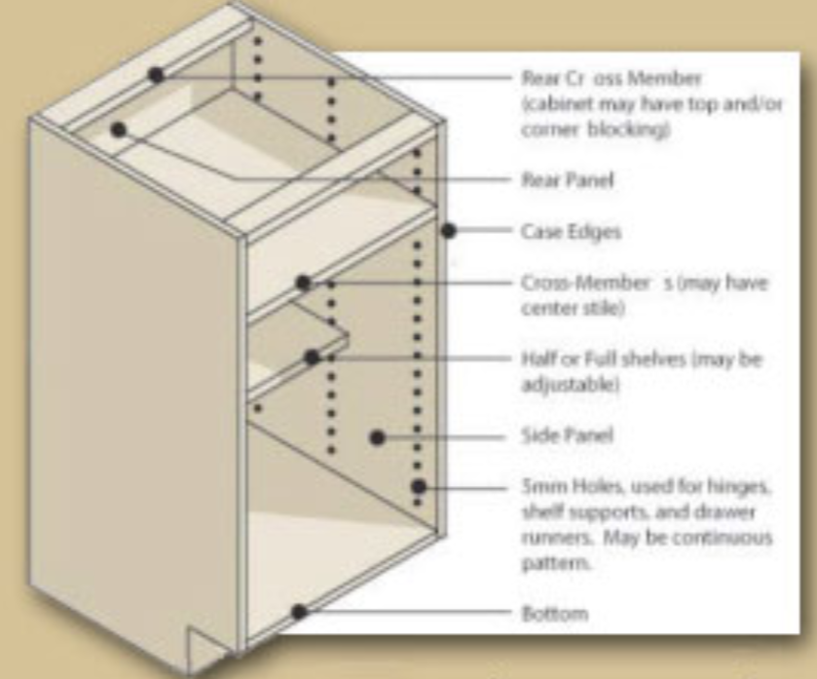
Hallucination
Let’s try to enhance this image to improve readability.
Another example:
“Let's try a modern twist on classic Reshmi Gola Kabab. We will grill it in oven and garnish with roasted walnuts and a touch of papaya essence. We'd like to serve it as a platter with famous Cuban tea and sandalwood chopsticks. Give me a complete recipe for this.”
What’s happening here?
Notes:
Facts: You don’t grill Gola kabab; it is never garnished with roasted nuts; papaya essence will ruin the taste; Cubans don’t even drink tea; who eats Reshmi kabab with chopsticks?
Hallucination is one of the bugs in LLMs. They try to produce an answer made-up facts.

Slide 9

Hallucination
Hallucination is caused due to LLM’s tendency to generate new content.
Types:
Logical contradiction
Factual inaccuracy
Prompt contradiction
Nonsensical output
Irrelevant output
How to mitigate?
Prompt structuring
Prompt parameters
Shot prompting
Human-in-loop validation

Slide 10
Source Verification
Attribution: providing references and citations
Retrieval Augmented Generation (RAG)
Pre-existing knowledge from authentic sources
PubMed
Wikipedia
Google Scholar
Blockchains
Lack of real-time access
Fake news
Contextual mismatch
“Provide me references to the original papers which introduced self-attention in LLMs”

Slide 11
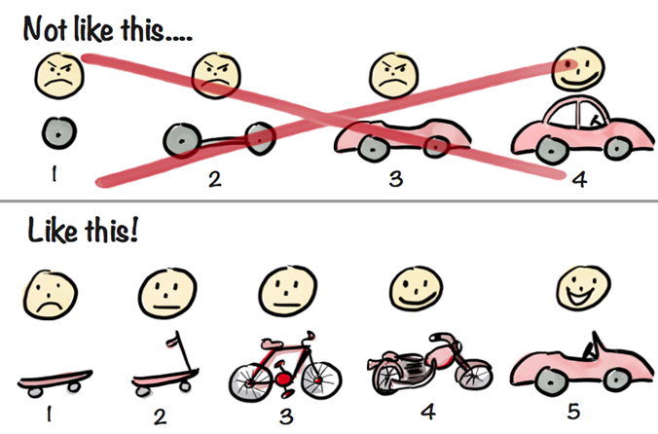
Iterative Refinement
Prompt structuring vs Iterative refinement
Let’s design a writing table:
“Design me a writing table”.
... Some response …
“My daughter is only 3ft 5. Make it smaller.”
… Refined response …
“It should be foldable. I also need a stationery compartment”
… More refinement …
“I forgot to mention. It should also be wide enough for a 14” laptop and mouse.”
Notes:
Start with something basic and keep refining if you’re unsure of your exact needs

Slide 12
That’s it!
You are now equipped to try anything and everything on LLMs. You’re limited only by your imagination.
Questions?

